Slide 1
Project Chiron Interface Fall 2017 Progress Report
Marie Bomber
Aaron Leondar
Hadi Rahal-Arabi

Slide 2
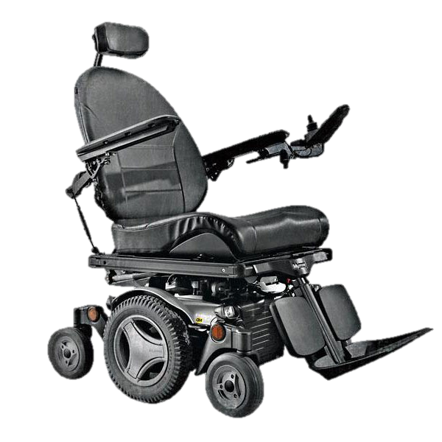
Background
Project Chiron
Using a Permobil wheelchair
Power-Mobility Indoor Driving Assessment
Move from Occupational Therapist assessment to using wheelchair sensor data
Permobil M300
© ILS Rehab

Slide 3
Project Goals
Streamline research collection process
Ensure test files are kept to a reasonable size
Securely store test data
Provide easy access for researcher to work with data set
Document hardware for future developers

Slide 4
Project Reponsibilities
Aaron Leondar
Connection to wheelchair and processing of ROS data
Marie Bomber
Storage and retrieval of ROS data
Organizing project requirements and timelines
Hadi Rahal-Arabi
User Interface(s)

Slide 5
Project Chiron Interface Fall 2017 Progress Report
Marie Bomber
Aaron Leondar
Hadi Rahal-Arabi

Slide 6
Ongoing Tasks
Creating dummy for user interface
Preparing temporary development space (e.g. AWS?)
Determining storage location

Slide 7
Immediate Future
Collect data from turtlebot
Document hardware (12/6/2017)
Begin truncating/compressing bags

Slide 8
Stumbling Blocks
Transition from node webapp to python application
Retroactive update for tech review
Need to research how to develop a python daemon
Early delivery date

Slide 9
Project Chiron Interface Fall 2017 Progress Report
Marie Bomber
Aaron Leondar
Hadi Rahal-Arabi

Slide 10
Week 0 and 1 (Sept. 20th-29th)
No actual group work done
Ended up on Wheelchair Data Collection Project

Slide 11
Week 2 (Sept. 30th-October 6th)
Had first meeting with client, Matthew Shuman
Gathered general data about project (where it will be performed, about when it will be done, possible stretch goals)
Started working on problem statement

Slide 12
Week 3 (Oct. 7th-13th)
Set up Github repository
Had first meeting with TA, Junki
Had another meeting with Professor Shuman
Got feedback on rough problem statement
Got a clearer understanding for how data would be collected
Submitted problem statement

Slide 13
Week 4 (Oct. 14th-20th)
Had another meeting with Professor Shuman
Got a chance to actually see the wheelchair that we will be working with
Started dividing up main project responsibilities, based on the most important components of the project

Slide 14
Week 5 (Oct. 21st-27th)
Started working on requirements document
Split the group into three main portions of the project
Robot Communication Layer
Data Storage
User Interface

Slide 15
Week 6 (Oct. 28th-Nov. 3rd)
Met with Kirsten Winters and Professor Shuman to discuss requirements document improvements
Got a time to work with the wheelchair officially during finals week while in meeting from Professor Shuman
Continued work on requirements document, using critique from client meeting

Slide 16
Week 7 (Nov. 4th-10th)
Not much team level work this week
Main focus was working on tech review on our specific sections:
Robot Communication Layer
Data Storage
User Interface

Slide 17
Week 8 (Nov. 11th-17th)
Very similar work done as the previous week
Continued work on researching the technologies we could use and finding the most effective ones
Had another meeting with Professor Shuman
Discussed who will be running the tests/what that means for the UI

Slide 18
Week 9 (Nov. 18th-24th)
Revised tech review documents
Not much other concrete work done due to Thanksgiving holiday, mostly just research

Slide 19
Week 10 (Nov. 25th-Dec 1st)
Proposed a mock-up of User Interface
Planned for our wheelchair time during finals week
Worked on design document, as well as our progress report

Slide 20
Week 11 and the future! (Dec 2nd ongoing)
Hands-on time with robot/wheelchair: Wednesday December 6th for four hours
Project should be done and ready for testing by mid February

